Slide 1

Exoplanet Prediction
David Kinney – DSC680 – Spring 2021
Professor Catherine Williams
Project 1

Slide 2
What is an exoplanet (and how do we find them)?
Stellar objects that revolve around a star.
Exoplanets are very hard to see directly with telescopes. They are hidden by the bright glare of the stars they orbit.
One way to search for exoplanets is to look for "wobbly" stars. A star that has planets doesn’t orbit perfectly around its center. From far away, this off-center orbit makes the star look like it’s wobbling.
Source: What Is an Exoplanet? | NASA Space Place – NASA Science for Kids

Slide 3
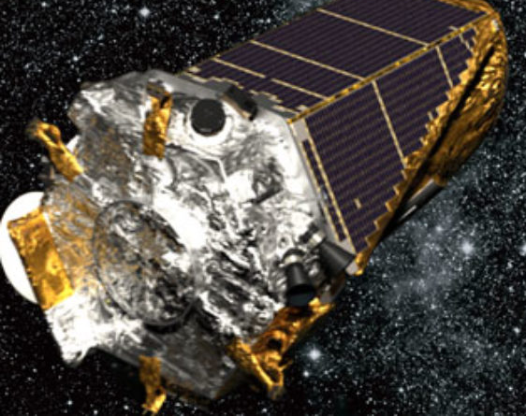
The Kepler Spacecraft
In 2009, NASA launched the Kepler spacecraft to look for exoplanets.
Planets in a wide range of sizes orbiting around stars that varied in size and temperature.
Some of the planets discovered by Kepler are rocky planets that are at a very special distance from their star. This sweet spot is called the habitable zone, where life might be possible.
Source: NASA's Kepler Spacecraft Recovered from Emergency Mode - Sky & Telescope - Sky & Telescope (skyandtelescope.org)
Notes:
As an exoplanet passes in front of a more distant star, its gravity bends the trajectory of a background star's light. If the alignment is right, the background star briefly brightens. This phenomenon of gravitational microlensing enables scientists to search for exoplanets that are too distant and dark to detect any other way. Source: NASA Ames / JPL-Caltech / T. Pyle

Slide 4
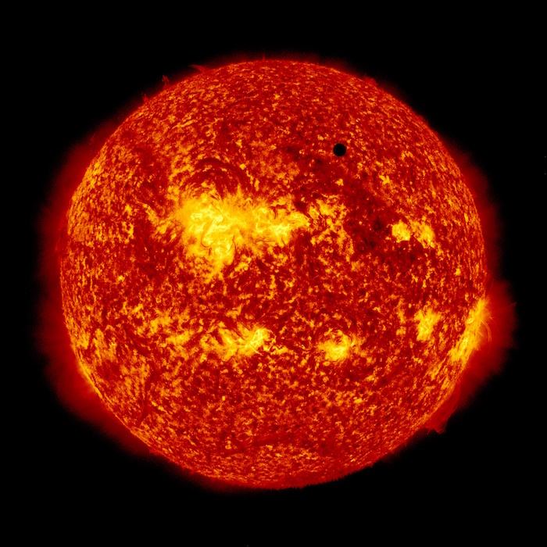
The Transit method…
Kepler detected exoplanets using something called the transit method. When a planet passes in front of its star, it’s called a transit. As the planet transits in front of the star, it blocks out a little bit of the star's light. That means a star will look a little less bright when the planet passes in front of it.
Astronomers can observe how the brightness of the star changes during a transit. This can help them figure out the size of the planet.
By studying the time between transits, astronomers can also find out how far away the planet is from its star. This tells us something about the planet’s temperature. If a planet is just the right temperature, it could contain liquid water—an important ingredient for life.
Venus transiting our Sun back in 2012. Credit: NASA Solar Dynamics Observatory

Slide 5
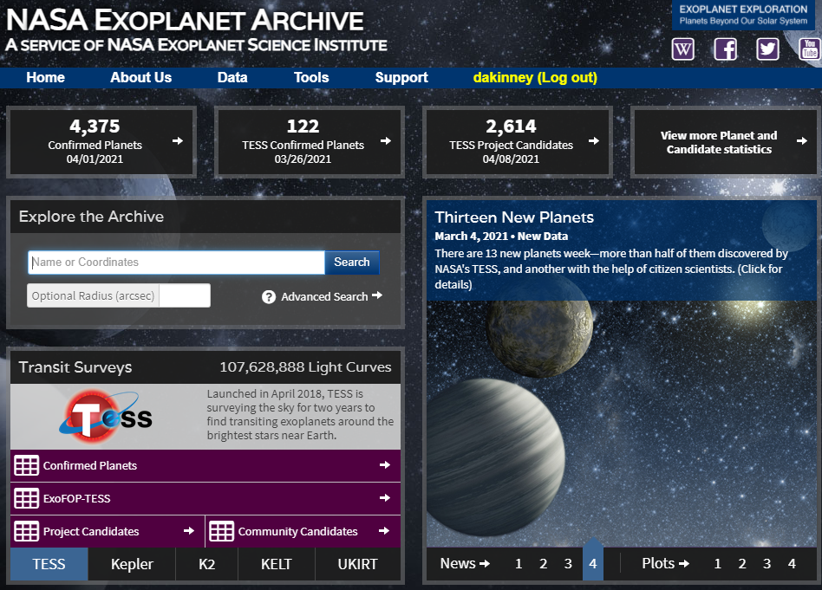
The NASA Exoplanet Archive
Kepler Objects of Interest (KOI) database
KOIs are well vetted, periodic, transit-like events in the Kepler data.
The Kepler Project identifies these objects from the Threshold-crossing Event (TCE) list for further vetting.
Some objects will be flagged as false positives.

Slide 6
The Kepler Objects of Interest (KOI) Cumulative Database
Identification Columns
Exoplanet Archive Information
Project Disposition Columns
Transit Properties
Threshold-Crossing Event (TCE) Information
Stellar Parameters
KIC Parameters
Pixel-Based KOI Vetting Statistics
Notes:
Refer to your separate notes…

Slide 7

Hypothesis and Approach…
Can a Machine Learning classifier be trained to categorize KOI observations as a confirmed exoplanet, a candidate, or a false positive
Random Forest:
Multi-class classification
Many decision trees are trained.
“Wisdom of the crowd”
Notes:
Elaborate on “wisdom of the crowd”

Slide 8
The Machine Learning process…
Features removed:
Descriptive/Informational
All values were NaN
All values were 0 or 0.0
“err” columns
Categorical
Dimensionality Reduction
Reduced features from 53 to 29
Split dataset
Dataset was split into 75% Train and 25% Test datasets
Models trained:
Random Forest Classifier: base and with randomized search
SVM, ADABoost, XGBoost, TPOT
Training distribution:
FALSE POSITIVE 0.508853
CANDIDATE 0.246062
CONFIRMED 0.245086
Test distribution:
FALSE POSITIVE 0.497700
CANDIDATE 0.251359
CONFIRMED 0.250941
Notes:
Explain what an “err” column is and why you removed them. Explain why you removed the categorical variables. Note the size of the original dataset and the split statistics. Define the other models tested

Slide 9
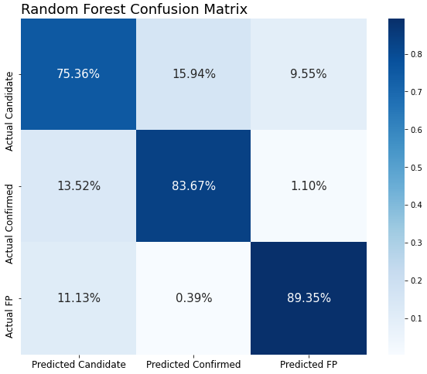
Conclusions…
Accuracy was better without PCA (86% vs. 78)
No other models performed better than a Random Forest Classifier.
Model was best at predicting False Positives and worst at predicting Candidates.
Accuracy may be improved with a larger dataset.
 | Precision | Recall | F1-score | Support
Candidate | 0.78 | 0.66 | 0.71 | 601
Confirmed | 0.86 | 0.87 | 0.87 | 600
False Positive | 0.89 | 0.96 | 0.93 | 1190
Accuracy |  |  | 0.86 | 2391
Macro avg | 0.85 | 0.83 | 0.84 | 2391
Weighted avg | 0.86 | 0.86 | 0.86 | 2391
 | Predicted Candidate | Predicted Confirmed | Predicted False Positive
Actual Candidate | 1104 | 289 | 372
Actual Confirmed | 198 | 1517 | 43
Actual False Positive | 163 | 7 | 3480
Notes:
I would’ve liked to see accuracy above 90%, but that might be achievable with a larger dataset and some additional tuning or model selection. Overall, I’m confident there is a valid case for a ML model.

Slide 10

Questions…
Regarding the decision to exclude the 8 categorical variables, can you elaborate on what they represented?
In retrospect, would any of them add any value to the model’s accuracy?
Why did you decide to employ a standard scaler, as opposed to say, a min/max scaler?
In your initial proposal, you were going to train the model on subsets based on the 6 categories. What changed your mind?
Do you feel this is still something worth pursuing?
Why did you decide to employ a Random Forest Classifier?
Are there any other models you feel may give you better results?
What other methods might you employ to improve the accuracy of your model?
You state in your paper that a randomized grid search did not result in model improvement. Had you considered applying a genetic algorithm to perform hyperparameter tuning?

